Slide 1
User Interface Components with Swing

Slide 2
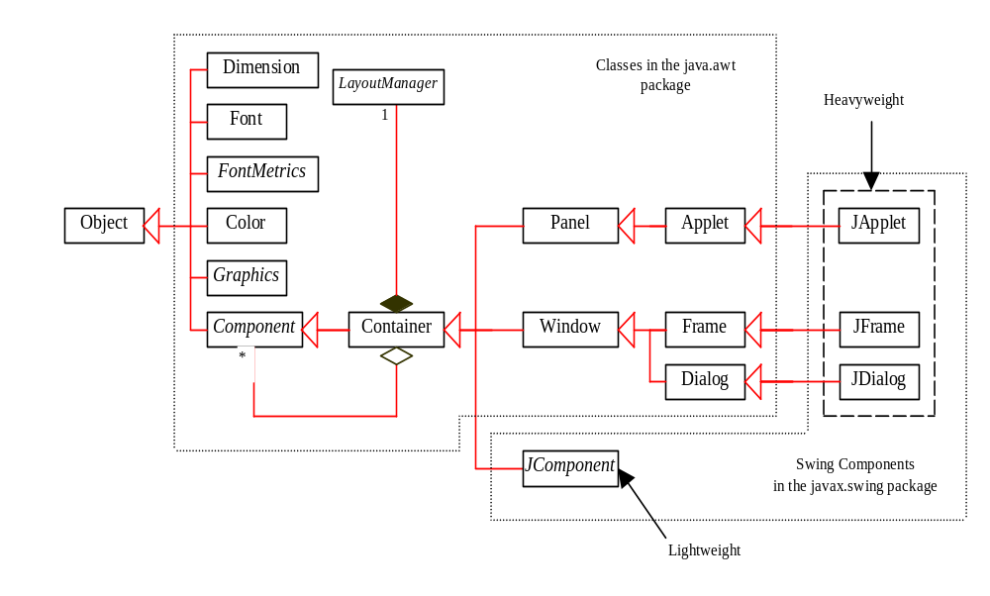
GUI Class Hierarchy (Swing)

Slide 3
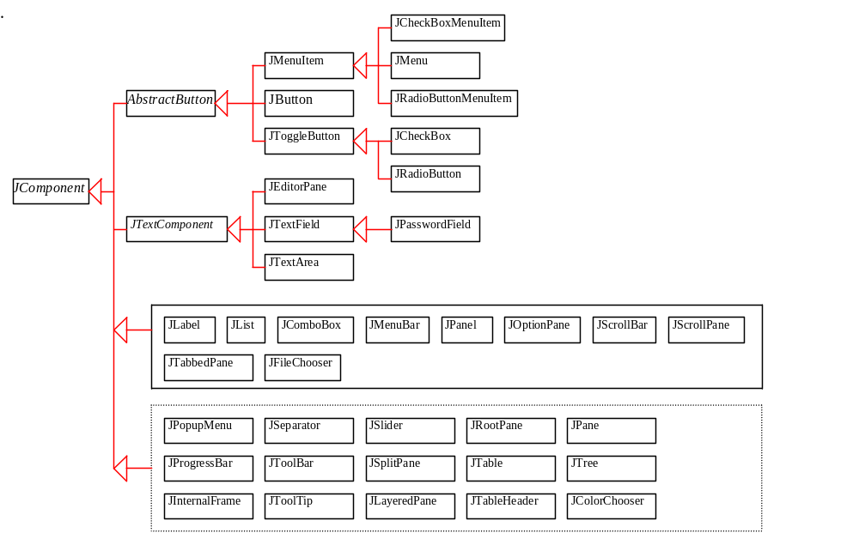
JComponent

Slide 4
To Make an Interactive GUI Program
To make an interactive GUI program, you need:
  Components
    buttons, windows, menus, etc.
  Events
    mouse clicked, window closed, button clicked, etc.
  Event listeners (interfaces) and event handlers (methods)
    listen for events to be trigged, and then perform actions to handle them

Slide 5
Event Basics
All Events are objects of Event Classes.
All Event Classes derive from EventObject.
When an Event occurs, Java sends a message to all registered Event Listeners from the Event source.

Slide 6
Registering Event Listeners
To register a listener object with a source object, you use lines of code that follow the model
source.addEventListener(eventListenerObject);

Slide 7
Event Listeners
When the user clicks the button, the JButton object generates an ActionEvent object.
This calls the listener object’s actionPerformed() method and passes that method the event object it just generated.
Note that a single event source can have multiple listeners listening for its events. In this case, the source calls the actionPerformed() method of each of its listeners when the event is generated.

Slide 8
Event Handling Model of AWT
Event object
Event handling
methods
Event source
Event listener

Slide 9
Action Events on Buttons
ActionEvent
actionPerformed(..)
Button
ActionListener

Slide 10
How to Attach an Event Listener to an Event Source
o is an event source
h is an event listener of type XXX
o.addXXX(h)
where XXX is one of the following:
  ActionListener
  MouseListener
  MouseMotionListener
  KeyListener
  WindowListener
  ComponentListener
  FocusListener
  TextListener
  AdjustmentListener
  ItemListener

Slide 11
The ActionListener Interface
interface ActionListener {
public void actionPerformed(ActionEvent e);
}
Possible event sources
  Button
  List
  TextField
  MenuItem

Slide 12
version 1
JButton hw = new JButton("Hello World!");
panel.add(hw);
hw.addActionListener(new ActionListener(){
public void actionPerformed(ActionEvent e){
System.exit(0); } });

Slide 13
version 2
class MyFrame extends Jframe implements ActionListener
{ public MyFrame(){
JButton hw = new JButton("Hello World!");
panel.add(hw);
hw.addActionListener(this);
}
public void actionPerformed(ActionEvent o){
System.exit(0);
}
}

Slide 14
version 3
class MyFrame extends Jframe {
Button hw;
{ public MyFrame(){
JButton hw = new JButton("Hello World!");
panel.add(hw);
hw.addActionListener(new MyActionListener()); }
}
}
class MyActionListener implements ActionListener {
public void actionPerformed(ActionEvent o){
System.exit(0);
}
}

Slide 15

Events Handling
Every time a user types a character or pushes a mouse button, an event occurs.
Any object can be notified of an event by registering as an event listener on the appropriate event source.
Multiple listeners can register to be notified of events of a particular type from a particular source.

Slide 16
Event Handling in Java
Act that results in the event | Listener type
User clicks a button, presses Return while typing in a text field, or chooses a menu item | ActionListener
User closes a frame (main window) | WindowListener
User presses a mouse button while the cursor is over a component | MouseListener
User moves the mouse over a component | MouseMotionListener
Component becomes visible | ComponentListener
Component gets the keyboard focus | FocusListener
Table of list selection changes | ListSelectionListener

Slide 17
Implementing an Event Handler
Implement a listener interface or extend a class that implements a listener interface.
Register an instance of the event handler class as a listener upon one or more components.
Implement the methods in the listener interface to handle the event.

Slide 18
import javax.swing.*;
import java.awt.*;
import java.awt.event.*;
class ButtonListener implements ActionListener {
public void actionPerformed (ActionEvent e) {
System.out.println ("Got a button press:” + e);
}
}
public class Main {
private static void showGUI() {
JFrame frame = new JFrame("Swing GUI");
java.awt.Container content = frame.getContentPane();
content.setLayout(new FlowLayout());
content.add(new JLabel ("Yo!"));
JButton button = new JButton ("Click Me");
button.addActionListener(new ButtonListener());
content.add(button);
frame.pack();
frame.setVisible(true);
}

Slide 19

class ButtonListener implements ActionListener {
public void actionPerformed (ActionEvent e) {
if (e.getActionCommand().equals ("On")) {
System.out.println("On!");
} else if (e.getActionCommand().equals("Off")) {
System.out.println("Off!");
} else {
System.out.println("Unrecognized button press!"); } } }
public class Main {
private static void showGUI() {
…
ButtonListener bl = new ButtonListener();
JButton onButton = new JButton ("On");
onButton.addActionListener(bl);
content.add(onButton);
JButton offButton = new JButton ("Off");
offButton.addActionListener(bl);
content.add(offButton);
…

Slide 20
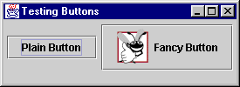
JButton
Methods of class Jbutton
  JButton myButton = new JButton( "Label" );
  JButton myButton = new JButton( "Label", myIcon );
  setRolloverIcon( myIcon )
    Sets image to display when mouse over button
Class ActionEvent getActionCommand
    returns label of button that generated event
Icon bug1 = new ImageIcon( "bug1.gif" );
fancyButton = new JButton("Fancy Button", bug1 );
fancyButton.setRolloverIcon( bug2 );

Slide 21
JCheckBox
When JCheckBox changes
  ItemEvent generated
    Handled by an ItemListener, which must define itemStateChanged
  Register handlers with with addItemListener
Class ItemEvent
  getStateChange
    Returns ItemEvent.SELECTED or ItemEvent.DESELECTED
private class CheckBoxHandler implements ItemListener {
public void itemStateChanged( ItemEvent e )

Slide 22
1 // Fig. 12.12: CheckBoxTest.java
2 // Creating Checkbox buttons.
3 import java.awt.*;
4 import java.awt.event.*;
5 import javax.swing.*;
6
7 public class CheckBoxTest extends JFrame {
8 private JTextField t;
9 private JCheckBox bold, italic;
10
11 public CheckBoxTest()
12 {
13 super( "JCheckBox Test" );
14
15 Container c = getContentPane();
16 c.setLayout(new FlowLayout());
17
18 t = new JTextField( "Watch the font style change", 20 );
1. import
1.1 Declarations
1.2 Initialize JCheckBoxes
1.3 Register event handler
19 t.setFont( new Font( "TimesRoman", Font.PLAIN, 14 ) );
20 c.add( t );
21
Create JCheckBoxes
22 // create checkbox objects
23 bold = new JCheckBox( "Bold" );
24 c.add( bold );
25
26 italic = new JCheckBox( "Italic" );
27 c.add( italic );
28
29 CheckBoxHandler handler = new CheckBoxHandler();
30 bold.addItemListener( handler );

Slide 23
31 italic.addItemListener( handler );
32
33 addWindowListener(
34 new WindowAdapter() {
35 public void windowClosing( WindowEvent e )
36 {
37 System.exit( 0 );
38 }
39 }
40 );
41
42 setSize( 275, 100 );
43 show();
44 }
Because CheckBoxHandler implements ItemListener, it must define method itemStateChanged
45
46 public static void main( String args[] )
47 {
48 new CheckBoxTest();
49 }
50
51 private class CheckBoxHandler implements ItemListener {
52 private int valBold = Font.PLAIN;
getStateChange returns ItemEvent.SELECTED or ItemEvent.DESELECTED
53 private int valItalic = Font.PLAIN;
54
55 public void itemStateChanged( ItemEvent e )
56 {
57 if ( e.getSource() == bold )
58 if ( e.getStateChange() == ItemEvent.SELECTED )
59 valBold = Font.BOLD;
60 else
61 valBold = Font.PLAIN;

Slide 24
JRadioButton
Radio buttons
  Have two states: selected and deselected
  Normally appear as a group
    Only one radio button in group selected at time
    Selecting one button forces the other buttons off
  Mutually exclusive options
  ButtonGroup - maintains logical relationship between radio buttons
Class JRadioButton
  Constructor
    JRadioButton( "Label", selected )
    If selected true, JRadioButton initially selected

Slide 25
1 // Fig. 12.12: RadioButtonTest.java
2 // Creating radio buttons using ButtonGroup and JRadioButton.
3 import java.awt.*;
4 import java.awt.event.*;
5 import javax.swing.*;
6
7 public class RadioButtonTest extends JFrame {
8 private JTextField t;
9 private Font plainFont, boldFont,
10 italicFont, boldItalicFont;
11 private JRadioButton plain, bold, italic, boldItalic;
12 private ButtonGroup radioGroup;
13
14 public RadioButtonTest()
15 {
16 super( "RadioButton Test" );
17
18 Container c = getContentPane();
1. import
1.1 Declarations
1.2 Initialization
19 c.setLayout( new FlowLayout() );
Initialize radio buttons. Only one is initially selected.
20
21 t = new JTextField( "Watch the font style change", 25 );
22 c.add( t );
23
24 // Create radio buttons
25 plain = new JRadioButton( "Plain", true );
26 c.add( plain );
27 bold = new JRadioButton( "Bold", false);
28 c.add( bold );
29 italic = new JRadioButton( "Italic", false );
30 c.add( italic );

Slide 26
31 boldItalic = new JRadioButton( "Bold/Italic", false );
32 c.add( boldItalic );
33
34 // register events
35 RadioButtonHandler handler = new RadioButtonHandler();
Create a ButtonGroup. Only one radio button in the group may be selected at a time.
36 plain.addItemListener( handler );
37 bold.addItemListener( handler );
38 italic.addItemListener( handler );
39 boldItalic.addItemListener( handler );
40
41 // create logical relationship between JRadioButtons
42 radioGroup = new ButtonGroup();
Method add adds radio buttons to the ButtonGroup
43 radioGroup.add( plain );
44 radioGroup.add( bold );
45 radioGroup.add( italic );
46 radioGroup.add( boldItalic );
47
48 plainFont = new Font( "TimesRoman", Font.PLAIN, 14 );
49 boldFont = new Font( "TimesRoman", Font.BOLD, 14 );
50 italicFont = new Font( "TimesRoman", Font.ITALIC, 14 );
51 boldItalicFont =
52 new Font( "TimesRoman", Font.BOLD + Font.ITALIC, 14 );
53 t.setFont( plainFont );
54
55 setSize( 300, 100 );
56 show();
57 }
58

Slide 27
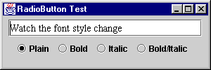
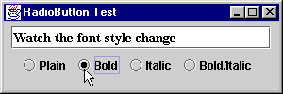
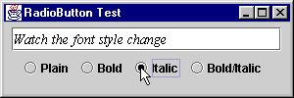
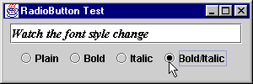

Slide 28
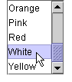
Jlist with
List
  Displays series of items
  may select one or more items
Class JList
  Constructor JList( arrayOfNames )
    Takes array of Objects (Strings) to display in list
  setVisibleRowCount( n )
    Displays n items at a time
    Does not provide automatic scrolling

Slide 29
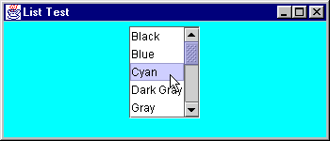
30 // create a list with the items in the colorNames array
31 colorList = new JList( colorNames );
32 colorList.setVisibleRowCount( 5 );
Initialize JList with array of Strings, and show 5 items at a time.
33
34 // do not allow multiple selections
35 colorList.setSelectionMode(
36 ListSelectionModel.SINGLE_SELECTION );
37
38 // add a JScrollPane containing the JList
Make the JList a single-selection list.
39 // to the content pane
40 c.add( new JScrollPane( colorList ) );
41
42 // set up event handler
Create a new JScrollPane object, initialize it with a JList, and attach it to the content pane.
43 colorList.addListSelectionListener(
44 new ListSelectionListener() {
45 public void valueChanged( ListSelectionEvent e )
46 {
47 c.setBackground(
48 colors[ colorList.getSelectedIndex() ] );
49 }
50 }
Change the color according to the item selected (use getSelectedIndex).
51 );
52
53 setSize( 350, 150 );
54 show();
55 }
56
57 public static void main( String args[] )
58 {
59 ListTest app = new ListTest();

Slide 30
Event-Handling Model
Some GUIs are event driven — they generate events when the user interacts with the GUI
  E.g, moving the mouse, clicking a button, typing in a text field, selecting an item from a menu, etc.
  When a user interaction occurs, an event is sent to the program. Many event types are defined in packages java.awt.event and javax.swing.event
some event classes in package java.awt.event
ActionEvent
ContainerEvent
AdjustmentEvent
FocusEvent
KeyEvent
ComponentEvent
InputEvent
MouseEvent
ItemEvent
PaintEvent
TextEvent
WindowEvent
key
CLASS
ABSTRACT CLASS

Slide 31
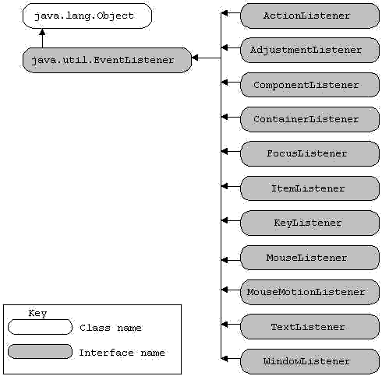
Event-Handling Model
Three parts of the event-handling mechanism
  event source: the GUI component with which the user interacts
  event object: encapsulated information about the occurred event
  event listener: an object which is notified by the event source when an event occurs, and provides responds to the event
two tasks to process a GUI event
  1. register an event listener
    An object of a class that implements one or more of the event-listener interfaces from packages java.awt.event and javax.swing.event
  implement an event handling method
Event-listener interface of package java.awt.event

Slide 32
Other Listener Classes
So far, we’ve only dealt with ActionListeners, which only have 1 method defined, actionPerformed.
Some Event classes have multiple methods defined,
public interface WindowListener {
void windowOpened(WindowEvent e);
void windowClosing(WindowEvent e);
void windowClosed(WindowEvent e);
void windowIconified(WindowEvent e);
void windowDeIconified(WindowEvent e);
void windowActivated(WindowEvent e);
void windowDeActivated(WindowEvent e);
}

Slide 33
Adapter Classes
Well, since these are interfaces, it means you have to defined every method listed. So, to add an windowListener to a JFrame, you’d have to
JFrame frame=new JFrame();
frame.addWindowListener(new WindowListener()
{
public void windowOpened(WindowEvent e)
{
Log.journal(“Frame Opened”);
}
public void windowClosed(WindowEvent e) {}
public void windowIconified(WindowEvent e) {}
//… for every method in the Interface
});

Slide 34
Adapter Classes
Java provides something called Adapter classes, which will overload these methods automatically to do nothing. You can then overload the select ones to do what you want

Slide 35
Adapter Classes
public class winAdapter extends WindowAdapter
{
//WindowAdapter overloads all 7 methods in the WindowListner interface
//Now we overload those we want to do something
public void windowClosing(WindowEvent e)
{
System.exit(0);
}
}
JFrame ourFrame=new JFrame();
ourFrame.addWindowListener(new winAdapter());

Slide 36
Adapter Classes
We can even bring this a level further. Just use an anonymous inner class to use the Adapter class.
JFrame ourFrame=new JFrame();
ourFrame.addWindowListener(new WindowAdapter()
{
public void windowClosing(WindowEvent e)
{
System.exit(0);
}
});

Slide 37
MouseListener
mouseClicked(MouseEvent)
  Invoked when the mouse has been clicked on a component.
mouseEntered(MouseEvent)
  Invoked when the mouse enters a component.
mouseExited(MouseEvent)
  Invoked when the mouse exits a component.
mousePressed(MouseEvent)
  Invoked when a mouse button has been pressed on a component.
mouseReleased(MouseEvent)
  Invoked when a mouse button has been released on a component.

Slide 38
MouseAdapter
class MouseAdapter implements MouseListener {
public void mouseClicked(MouseEvent e){}
public void mouseEntered(MouseEvent e){}
public void mouseExited(MouseEvent e){}
public void mousePressed(MouseEvent e){}
public void mouseReleased(MouseEvent e){}
}

Slide 39
Example
f.addMouseListener(new MouseAdapter(){
public void mouseClicked(MouseEvent e){
System.out.println("Mouse clicked: ("+e.getX()+","+e.getY()+")");
}
....
}

Slide 40
Drawing on Panels
JPanel can be used to draw graphics (including text) and enable user interaction.
To draw in a panel, you create a new class that extends JPanel and override the paintComponent method to tell the panel how to draw things.
You can then display strings, draw geometric shapes, and view images on the panel.

Slide 41
Drawing on Panels, cont.
public class DrawMessage extends JPanel {
/** Main method */
public static void main(String[] args) {
JFrame frame = new JFrame("DrawMessage");
frame.getContentPane().add(new DrawMessage());
frame.setDefaultCloseOperation(JFrame.EXIT_ON_CLOSE);
frame.setSize(300, 200);
frame.setVisible(true);
}
/** Paint the message */
public void paintComponent(Graphics g) {
super.paintComponent(g);
g.drawString("Welcome to Java!", 40, 40);
}
}

Slide 42
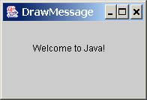
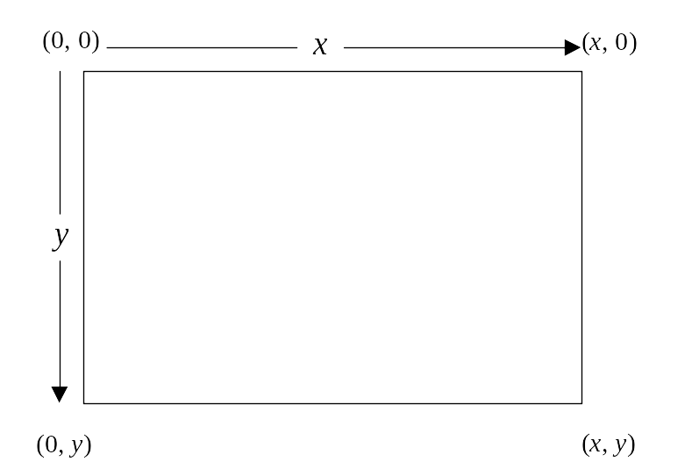
Drawing on Panels, cont.

Slide 43
Graphics Class
The Graphics class is an abstract class for displaying figures and images on the screen on different platforms.
paintComponent method to draw things on a graphics context g,
g is an instance of a concrete subclass of the abstract Graphics class for the specific platform.
The Graphics class encapsulates the platform details and enables you to draw things uniformly without concerning specific platforms.

Slide 44
Whenever a component is displayed, a Graphics object is created for the component.
paintComponent method to draw things.
super.paintComponent(g) is necessary to ensure that the viewing area is cleared before a new drawing is displayed.

Slide 45
The Color Class
You can set colors for GUI components by using the java.awt.Color class. Colors are made of red, green, and blue components, each of which is represented by a byte value that describes its intensity, ranging from 0 (darkest shade) to 255 (lightest shade). This is known as the RGB model.
Color c = new Color(r, g, b);
r, g, and b specify a color by its red, green, and blue components.
Example:
Color c = new Color(228, 100, 255);

Slide 46
Setting Colors
You can use the following methods to set the component’s background and foreground colors:
setBackground(Color c)
setForeground(Color c)
Example:
setBackground(Color.yellow); setForeground(Color.red);

Slide 47
The Font Class
Font myFont = Font(name, style, size);
Example:
Font myFont = new Font("SansSerif ", Font.BOLD, 16);
Font myFont = new Font("Serif", Font.BOLD+Font.ITALIC, 12);

Slide 48
Finding All Available Font Names
GraphicsEnvironment e =
GraphicsEnvironment.getLocalGraphicsEnvironment();
String[] fontnames = e.getAvailableFontFamilyNames();
for (int i = 0; i < fontnames.length; i++)
System.out.println(fontnames[i]);

Slide 49
Setting Fonts
public void paint(Graphics g) {
Font myFont = new Font("Times", Font.BOLD, 16);
g.setFont(myFont);
g.drawString("Welcome to Java", 20, 40);
//set a new font
g.setFont(new Font("Courier", Font.BOLD+Font.ITALIC, 12));
g.drawString("Welcome to Java", 20, 70);
}

Slide 50
Drawing Geometric Figures
Drawing Lines
Drawing Rectangles
Drawing Ovals
Drawing Arcs
Drawing Polygons

Slide 51
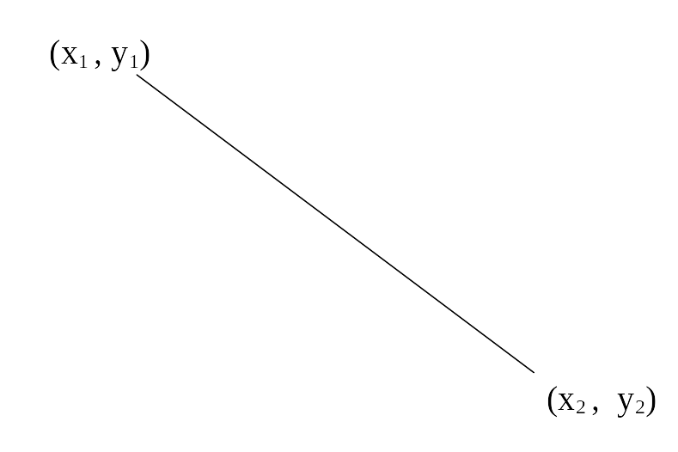
Drawing Lines
drawLine(x1, y1, x2, y2);

Slide 52
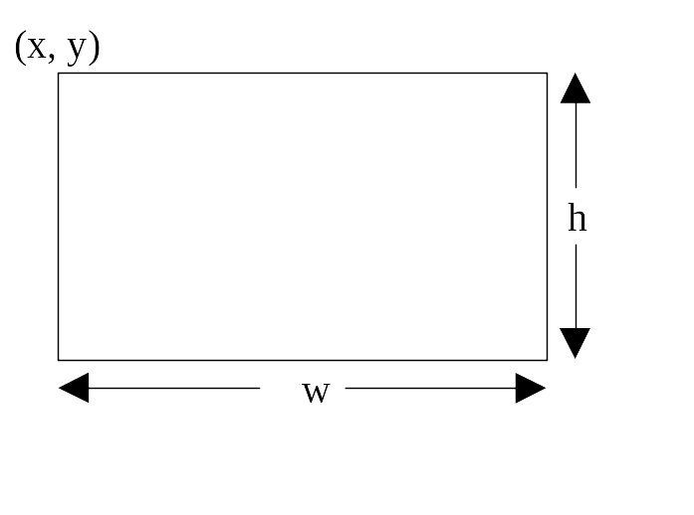
Drawing Rectangles
drawRect(x, y, w, h);
fillRect(x, y, w, h);

Slide 53
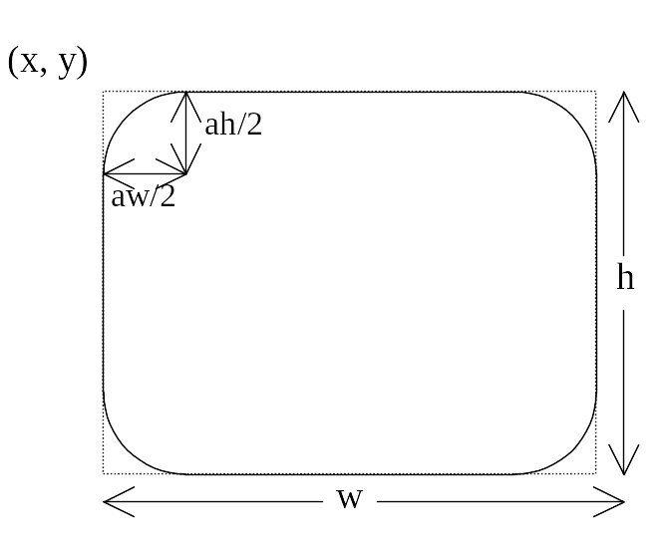
Drawing Rounded Rectangles
drawRoundRect(x, y, w, h, aw, ah);
fillRoundRect(x, y, w, h, aw, ah);

Slide 54
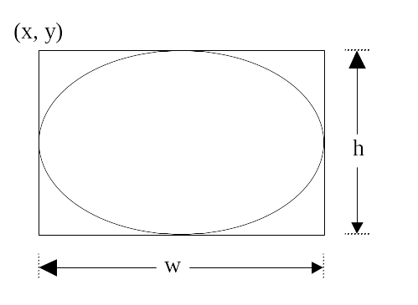
Drawing Ovals
drawOval(x, y, w, h);
fillOval(x, y, w, h);

Slide 55
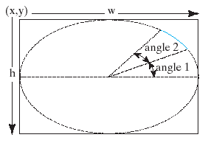
Drawing Arcs
drawArc(x, y, w, h, angle1, angle2);
fillArc(x, y, w, h, angle1, angle2);

Slide 56
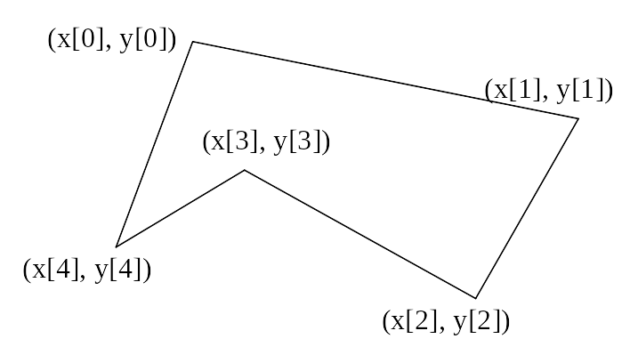
Drawing Polygons
int[] x = {40, 70, 60, 45, 20};
int[] y = {20, 40, 80, 45, 60};
g.drawPolygon(x, y, x.length);
g.fillPolygon(x, y, x.length);

Slide 57
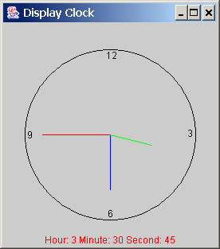
Drawing a Clock
Objective: Use drawing and trigonometric methods to draw a clock showing the specified hour, minute, and second in a frame.

Slide 58
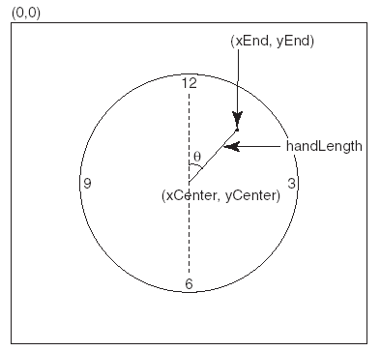
Drawing Clock
xEnd = xCenter + handLength × sin(θ)
yEnd = yCenter - handLength × cos(θ)
Since there are sixty seconds in one minute, the angle for the second hand is
second × (2π/60)

Slide 59
Drawing Clock, cont.
xEnd = xCenter + handLength × sin(θ)
yEnd = yCenter - handLength × cos(θ)
The position of the minute hand is determined by the minute and second. The exact minute value comined with seconds is minute + second/60. For example, if the time is 3 minutes and 30 seconds. The total minutes are 3.5. Since there are sixty minutes in one hour, the angle for the minute hand is
(minute + second/60) × (2π/60)

Slide 60
Drawing Clock, cont.
xEnd = xCenter + handLength × sin(θ)
yEnd = yCenter - handLength × cos(θ)
Since one circle is divided into twelve hours, the angle for the hour hand is
(hour + minute/60 + second/(60 × 60))) × (2π/12)

Slide 61
1 // Fig. 12.20: MouseDetails.java
2 // Demonstrating mouse clicks and
3 // distinguishing between mouse buttons.
4 import javax.swing.*;
Another example, illustrating mouse events in AWT and Swing
5 import java.awt.*;
6 import java.awt.event.*;
7
8 public class MouseDetails extends JFrame {
9 private String s = "";
10 private int xPos, yPos;
11
Add a listener for a mouse click.
12 public MouseDetails()
13 {
14 super( "Mouse clicks and buttons" );
15
16 addMouseListener( new MouseClickHandler() );
17
18 setSize( 350, 150 );
19 show();
20 }
21
22 public void paint( Graphics g )
23 {
24 g.drawString( "Clicked @ [" + xPos + ", " + yPos + "]",
25 xPos, yPos );
26 }
27

Slide 62
28 public static void main( String args[] )
29 {
30 MouseDetails app = new MouseDetails();
31
32 app.addWindowListener(
33 new WindowAdapter() {
34 public void windowClosing( WindowEvent e )
35 {
Use a named inner class as the event handler. Can still inherit from MouseAdapter (extends MouseAdapter).
36 System.exit( 0 );
37 }
38 }
39 );
40 }
41
42 // inner class to handle mouse events
43 private class MouseClickHandler extends MouseAdapter {
44 public void mouseClicked( MouseEvent e )
45 {
Use getClickCount, isAltDown, and isMetaDown to determine the String to use.
46 xPos = e.getX();
47 yPos = e.getY();
48
49 String s =
50 "Clicked " + e.getClickCount() + " time(s)";
51
52 if ( e.isMetaDown() ) // Right mouse button
53 s += " with right mouse button";
54 else if ( e.isAltDown() ) // Middle mouse button
55 s += " with center mouse button";
56 else // Left mouse button
57 s += " with left mouse button";
58

Slide 63
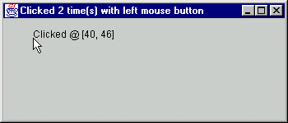
59 setTitle( s ); // set the title bar of the window
60 repaint();
61 }
Set the Frame’s title bar.
Program Output
62 }
63 }

